Slide 1
SCOM MM V1.0
-SANDEEP SINGH

Slide 2
Overview
The tool has been designed to put multiple servers in maintenance mode in SCOM at one go thereby reducing the manual effort and time elapsed.

Slide 3
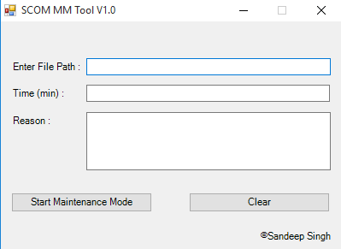
Initial Design

Slide 4
Working
Create a text file that consists of the server FQDNs which we wish to put in maintenance mode.
Provide the file path in first field.
Enter time duration (in minutes) of maintenance mode.
Enter reason of putting server in maintenance mode. This field has been set as optional considering the original functionality of SCOM.
Click Start Maintenance Mode.
Done. Servers are in maintenance mode.

Slide 5
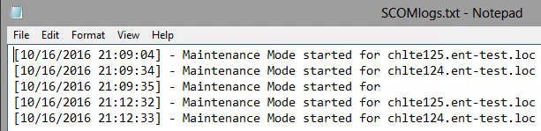
Insights
Log file is generated to keep a track of each server that has been put in maintenance mode.

Slide 6
Benefits
Windows patching.
Any planned activity.
Others

Slide 7
Bugs
You tell me !

Slide 8
What questions do I have?

Slide 9
Thank You ☺

